Slide 1
Adulting in the Library
Experiences of Millennial Employees in Adventist Libraries

Slide 2
Generational Definitions
  Silent or GI Generation (1925-1942)
  Baby Boomers (1943-1960)
  Generation X (1961-1979)
  Millennials (1980-2000)
  iGeneration (2001-2020?)
Notes:
These years are nearly identical to those used by Strauss & Howe in Generations: the history of America’s Future. Definitions for the generations are usually based on changes in birth rates. Some ranges cap the Millennial generation in the mid-90s because of a decrease in birth rates. Many of those also set the starting year in the late-70s when birth rates started rising. As we can see, all Millennials are at least 16 years old by now. The majority of them have already passed through college and are now entering the workforce. However, as Strauss & Howe remind us, “generations can be imprecise at the boundaries” (Generations pg. 37).

Slide 3
Key Millennial Traits
Comfortable with technology – grew up with it; readily adopting and adapting; multitasking; easily bored without it;
Enjoy working as a team – product of their education; cooperation; consensus; compromise;
Very self-aware – expressive; confident; assertive; seeking self-fulfillment;
Strong connections with people – long distance relationships; helicopter parents; global generation;
Notes:
Dan Tapscott (Growing up Digital) points to the emergence of the personal computer as the key to defining the Millennial generation, drawing parallels with the Boomer generation and the growth of television. Jenny Emanuel notes that “younger librarians…believe they can quickly learn new technologies” (Emanuel pg. 28) because they have always used technology and have matured alongside computers. Jean Twenge (Generation Me) interprets Millennial assertiveness as entitlement. Ron Alsop (The Trophy Kids Grow Up) notes that “technology has linked young people from all corners of the globe and allowed them to share information and experiences virtually" (pg. 18), much more than previous generations were able to creating a generation that shares similarities around the world.

Slide 4
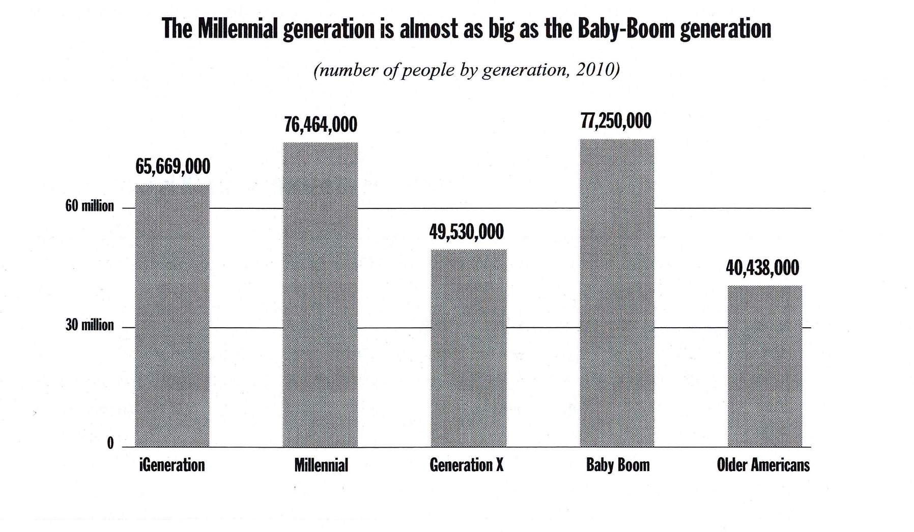
New Strategist Editors. (2012). The millennials: Americans born 1977 to 1994. Ithaca, NY: New Strategist Publications, Inc. (pg. 236).
Notes:
In the total population the Millennial and Baby Boom generations are nearly the same size. Both comprise about 38% of the available workforce population (Millennials, Gen X, Baby Boomers) while Gen X is 24%.

Slide 5
Staff at Adventist Libraries
Notes:
Based on answers from 5 NAD colleges/universities containing a total of 60 non-student library employees (about 44% of the total staff at NAD colleges). The proportions here do not reflect the distribution of the total population. Millennials represent less than half their expected proportion (15% v. 38%) while Gen X and Boomers make up most of the missing 23% fairly evenly with a slight edge to the Boomers.

Slide 6
Professional vs. Paraprofessional Employees
Notes:
Professional librarians constitute 55% of the total surveyed population. It is interesting to note the larger differences between professionals and paraprofessionals in the other generations, especially how the dominance of Boomer librarians seems to be balanced by an increased number of Gen X staff. Millennials are split fairly evenly between the two categories, making up 12% of the professional librarians and 19% of the paraprofessional staff.

Slide 7
Conversations with Millennial Librarians
All 3 have master’s degrees in Library Science; 2 have an additional master’s degree in another field.
All 3 are full-time, professional librarians in charge of specific library departments.
All 3 supervise student employees; 1 also supervises other staff.
Tenure in their current job is inversely proportionate to the number of previous library jobs held.
Two worked in libraries as student employees during their undergraduate studies.
Notes:
Along with myself, I was able to talk with two other Millennials about our experiences as library employees. The number of employees supervised is certainly related to the size of the institution.

Slide 8
What inspired your interest in library work?
“Getting hired to work as a student worker, finding I loved the intersection of books, technology, research, and helping patrons; figuring out there was a career in librarianship that touched on my major field of interest”
“I realized that I didn’t want to teach and I had no idea what else my humanities B.A. could do. My advisor…brought to work a clipping from the NYT about ‘hip young librarians,’ and I suddenly realized that was an actual career.”
My experience as a student employee in the library.
Notes:
For myself, I loved the organization and the access to information that the library provided. In the library, my tendency to be a generalist proved to be an asset.

Slide 9
What were some challenges you faced while trying to enter the workforce?
“The need for experience before you can get a job that gives you experience. Also the glut of temporary contract work is discouraging.”
“Doing the double masters that would allow me to practice in my specialization.”
Finding full-time work rather than part-time.
Notes:
Though temporary contract jobs can be a useful stepping stone and provide much needed experience, they don’t help much financially and are very reliant on location. Often one needs to be in the right place, at the right time, and have some other means of support in order to capitalize on these opportunities. Constricting library budgets are most likely the cause of these job-finding challenges.

Slide 10
What are some challenges you’ve faced in this profession?
“Being a young professional, I feel like I’ve had to work hard to “earn my stripes”, to prove that I’m actually a colleague, especially to those who were my undergraduate professors.”
“Scarcity of jobs, to a certain extent, is the largest challenge. Another issue in the day-to-day is low budgets, which mean you become stretched beyond your job duties and sometimes end up unable to complete the tasks you were originally hired to do.”
Budget cuts that restrict staff turnover and force remaining staff to take on extra responsibilities.
Notes:
The first comment finds a correlation with the experience of Pearl Ly, who became a library administrator within a few years after earning her master’s degree. She states that in interactions with fellow library administrators “the conversation usually gravitates to the question of how I convinced others that I was capable of being a library administrator after a relatively short time in the field” (Ly 66-67). The budgetary challenges are, of course, universal. Their unique impact on Millennials is likely in its effect on entering the field of library work. Once older employees retire their positions disappear or are merged into another position thus restricting the number of available jobs. This is especially detrimental since the Millennial population is nearly as numerous as the Boomer generation.

Slide 11
What are some challenges you have faced in trying to balance work and home life?
“Weekend and evening reference work is the only intrusion into this, but I am lucky to work at an SDA institution where Sabbath is sacred. I do not find this challenge insurmountable. I would not necessarily feel so confident and content with weekend/evening work if I was in a less family-oriented environment, or if I felt like I had to safeguard my Saturdays.”
“In many ways, I feel like balancing my work with my personal life has been the greatest challenge of the past five years as an academic librarian. I have to remember to take care of myself, and see my friends, and put in some gardening, and not just work, work, work in the office until 9pm.”
Notes:
These comments fit with the perception of how Millennials approach work. Alsop notes that “Millennials view work-life balance as their right” (Alsop 166) and Sujansky & Ferri-Reed suggest that “Millennials seem to possess a sense of regret over the absence of their Boomer parents from the life events that mattered most” (S & F-R 6). However, we can also see evidence that Millennials are willing to put in extra work as needed. The importance of balancing work and personal life is not due to Millennials devaluing the importance of work, but rather a broader cultural growth in the value of personal life. Twenge notes that this trend in valuing self-esteem began, at least in the U.S., as the Boomer generation reached adulthood in the 1960s and began changing the social culture of their predecessors.

Slide 12
What changes do you think libraries in general should make?
“I think we are already moving toward providing what the patron needs and expects, rather than what we think they want. This is a necessary move. We need to modify our collections, programs, services, policies, and more. We need to make these modifications to meet the needs of our users, and we need to be constantly adjusting based on feedback as well as advances in technology.”
“While the focus in the past decade or two has been on charging into an increasingly digital future, and in doing radical library renovations, I think we have to remember the traditions too, and old-school bibliography skills. I am always surprised by how many students tell me they appreciate having quiet study space. I think we also need to be cautious with the idea that just because it’s new, it’s better. Fads fade; we need to be smart about how we relate to change, adopting best practices where we can, but also not throwing out practices that work in favor of the new thing on the block just because it is new.”

Slide 13
Conclusions
How do Adventist librarians compare to general Millennial stereotypes?
What is unique about Millennial librarians?
Is there hope for the future?
Notes:
1) Inconclusive though there are indicators that suggest they fit. Further study focused on this question is needed to confirm. 2) It seems that one of the bigger issues is simply entering the profession indicated by the disproportionate distribution across generations. Participant statements about finding jobs could represent broader trends in Adventist libraries that are making it difficult for prospective librarians to join the workforce. 3) Certainly! Current Millennial librarians are in a good position to instigate changes as needed but aren’t necessarily looking to supplant the established culture. Promotion of the profession and mentoring of prospective employees will help them stay interested in joining despite the challenges.

Slide 14
Further Study
Increasing the number of participants.
Expanding to other Adventist libraries around the globe.
Interviews with Adventist librarians employed at non-Adventist institutions.
Comparing entry-level librarianship experiences across generations.
Researching the veracity of generational stereotypes as applied to the library profession.

Slide 15
Bibliography
Alsop, R. (2008). The trophy kids grow up: How the millennial generation is shaking up the workplace. San Francisco, CA: Jossey-Bass.
Emanuel, J. (2013). Digital native librarians, technology skills, and their relationship with technology. Information Technology and Libraries, 32(3), 20-33.
Ly, P. (2015). Young and in charge: early-career community college library leadership. Journal of Library Administration, 55(1), 60-68.
New Strategist Editors. (2012). The millennials: Americans born 1977 to 1994. Ithaca, NY: New Strategist Publications, Inc.
Strauss, W., & Howe, N. (1991). Generations: The history of America’s future, 1584-2069. New York, NY: Quill.
Sujansky, J. G., & Ferri-Reed, J. (2009). Keeping the millennials: Why companies are losing billions in turnover to this generation-and what to do about it. Hoboken, NJ: Wiley.
Tapscott, D. (1998). Growing up digital: The rise of the net generation. New York, NY: McGraw-Hill.
Twenge, J. M. (2006). Generation me: Why today’s young Americans are more confident, assertive, entitled-and more miserable than ever before. New York, NY: Free Press.

