Slide 1
Uppercase or Lowercase
Finding the Archives within the archives

Slide 2
Or…
What is the Difference
And Why Does it Matter?

Slide 3
Defining Archives
Society of American Archivists gives this definition on their website:
(also archive), n. ~ 1. Materials created or received by a person, family, or organization, public or private, in the conduct of their affairs and preserved because of the enduring value contained in the information they contain or as evidence of the functions and responsibilities of their creator, especially those materials maintained using the principles of provenance, original order, and collective control; permanent records. - 2. The division within an organization responsible for maintaining the organization's records of enduring value. - 3. An organization that collects the records of individuals, families, or other organizations; a collecting archives. - 4. The professional discipline of administering such collections and organizations. - 5. The building (or portion thereof) housing archival collections. - 6. A published collection of scholarly papers, especially as a periodical.

Slide 4
Pearce-Moses, Richard. A Glossary of Archival and Records Terminology. (Chicago, Ill.: The Society of American Archivists, 2005)

Slide 5
In common practice, most archivists differentiate the collections for which they are responsible into categories as follows:
Archives
Personal Papers
Manuscripts
Collections
Notes:
Archives = institutional / organizational collections
Personal Papers = Just what it says, the personal papers of an individual and organized/pulled together by that individual during their lifetime.
Manuscripts = single manuscripts with no institutional or authorial connection between them
Collections – artificial groupings of materials formed into a collection by the curator/custodian

Slide 6
So, what does it matter
?
Notes:
As most of you know, the reasons for archiving various institutional records is often a legal matter. And as there are legal issues for why some material must be kept; there are also legal issues surrounding the destruction of other papers.
If everything is jumbled together the issues of retention and destruction; access to be granted or denied, become a lot more complicated. Perhaps not intellectually, but the administration of access, etc., can be complicated.
Let me tell you a story of retention and destruction that went horribly wrong…
And one must always be on their toes when handling student records. Regulations much like hipaa for hospital records. I have to be able to assure the records creators that if they send the records to Archives as asked/required, these records won’t be open to any prying eyes that happen to enter the building. I have had to vigorously assure administrators that the materials will not be available on the open shelves in the Library; they will be kept behind locked doors. Access will be monitored and restrictions enforced.

Slide 7
When I arrived at Loma Linda University, Department of Archives and Special Collections…
Notes:
In the winter of 2006… okay, Southern California really doesn’t get “winter” like some other places do, but bear with me -- I had a little office down in the basement, some might say dungeon. Personally, I liked it. It was quiet and I was rarely interrupted. During my first days on the job, I tried to locate the University Archives – capital A – within the vast number of boxes in which were housed archival – lowercase a – collections. And within the unboxed materials on the shelves.
But what I found was…

Slide 8
Partially Organized Chaos
Most items and collections were boxed.
Most items and collections were listed in the accession ledger
Most items and collections were assigned a code and an accession number
Notes:
However, most of the boxes were not acid free, and they were stuffed too full.
But keep in mind this only applied to those items that were actually sent to “Archives”

Slide 9
List of Codes:
    AR FS PB
    AT FU PN
    BP GS PP
    CD IP SB
    CH LR SL
    CR MF TX
    DT MP UR
    EP MS VT
    FD MT WA
    FP OR WR
    FR PA …
Notes:
This list of codes – with definitions – was taped inside the archives ledger.
These codes were applied to University and non-university materials.

Slide 10
But knowing the code didn’t solve the problem.
Inaccuracy and inconsistency in assigning codes
Assigning codes that were not on the list
Materials with same code not shelved together
Accession ledger not computer searchable
Notes:
Give examples:
University records sometimes got UR, other times OR, or something completely different.
Usually, it is easy enough to figure out what the missing code stood for, i.e., PC = postcard, although according to the printed list of codes, postcards were supposed to be assigned EP.
Shelving boxes by code would have assisted me in bringing together all of the UR – if they had been consistently assigned that code. They weren’t
The accession ledger is a handwritten ledger and was not transcribed into an excel spreadsheet until a few years ago by our former secretary. So now I can do a word search, or I could sort by code, which can be useful but only insomuch as to the quality of information first written. The information in the ledger was written by an individual(s) for whom English was not his first language, and not one in which he was overly proficient. And again inconsistencies abound as to how entities were listed, etc. And then how the secretary interpreted the handwriting while transcribing the tomes.

Slide 11
I still didn’t have a clue as to where the University Archives was
?
Notes:
I could not physically point to University Archives.
Give brief history as to the upstairs/downstairs mentality. Sending things to “Archives”. Duplicate sets.

Slide 12
I feared it was all around me.
In boxes
On shelves
In cupboards
In closets
In the Women’s Restroom
Everywhere! And nowhere!

Slide 13
So, what was I going to do?
Notes:
Panic and tears didn’t help. I tried that. Some days, I would stand looking at the shelves and I would just scream. No one could hear me, and it was rather cathartic, but it didn’t really help get the job done.
First, I thought to pull all the boxed University records together. This was going to require shifting and reorganizing hundreds of boxes. I needed help.
A staff member volunteered to shift all the boxes for me. I have since learned that before setting a staff member loose on a project, make sure they understand all the nitty gritty details. My staff member did a great job, however as we know, boxes of papers had been inconsistently coded and labelled. My staff member was visually looking for boxes labelled “Loma Linda University” but often the individuals who had been working in Archives before I arrived would label the box based on the individual’s name, i.e., G. T. Anderson or Percy Magan or Newton Evans, failing to note that these men had served as President of the College of Medical Evangelists and Loma Linda University. I am still finding boxes of papers labelled with an individual’s name only to discover that the individual in question worked in the CME business office in the 50s and the papers are actually the official records of that time period.
But it was a start. At least the collections were now alphabetically shelved. And the old adage “look before you leap” became much more significant to me. Time to regroup.
Keep in mind that while I was working on the University Archives issue, I was also working on finding, organizing, and describing the non-University archival collections.

Slide 14
Next Steps…
Notes:
I decided to back up a step or two and take time to compose a University Archives Mission Statement.
Seemed like a good place to start. Know why I was going through all of this.

Slide 15
University Archives Mission Statement
The University Archives takes its mission from the mission of the institution, to educate:
By supporting and enabling the administration which provides and maintains the overall structure;
By determining what evidence is essential, ensuring that the institution creates such evidence, and making that evidence accessible to users regardless of location or format;
By preserving essential evidence of the institution;
By providing information that promotes the mission of the institution internally and to the extended community;
By supporting teaching and enhancing the curriculum as appropriate; and
By supporting the research of the faculty, students, and other scholars through access to information.
Notes:
I studied the mission statements of other colleges and universities – and blatantly and without remorse copied as I saw fit.
I also outlined out our constituents, created a Records Transfer Form, and met with various faculty/administration groups to discuss.

Slide 16
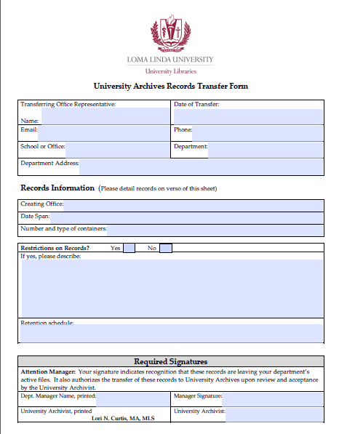
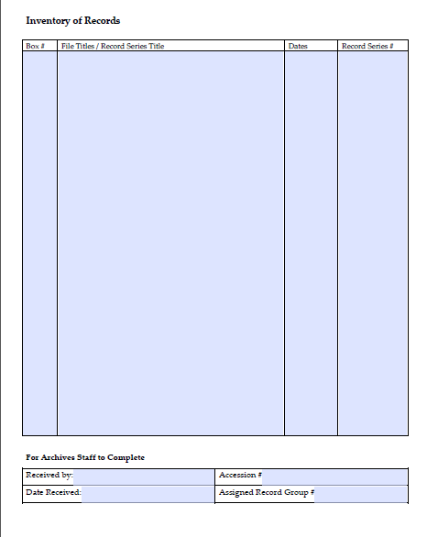
Notes:
But before I could get the University Archives organized, I needed to know how it was currently and historically organized. I need to grab hold of the University intellectually. I needed organizational charts.
We keep paper and electronic copies of the forms.

Slide 17
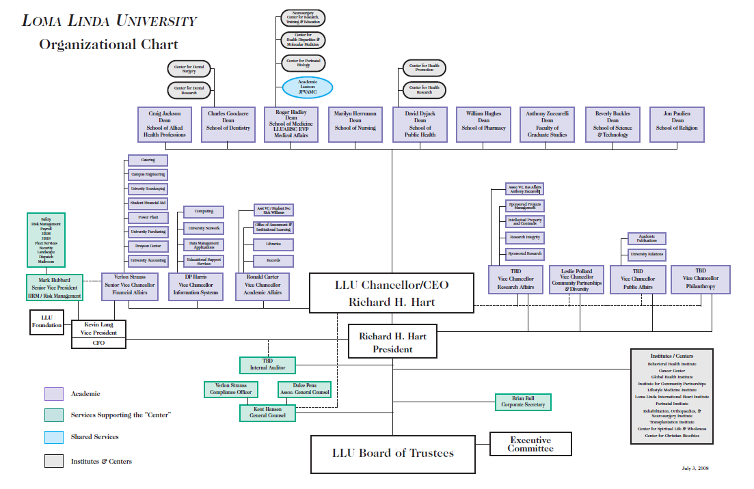
Notes:
This is one of the charts. And it was out-of-date almost before it was sent to me. So then I was sent…

Slide 18
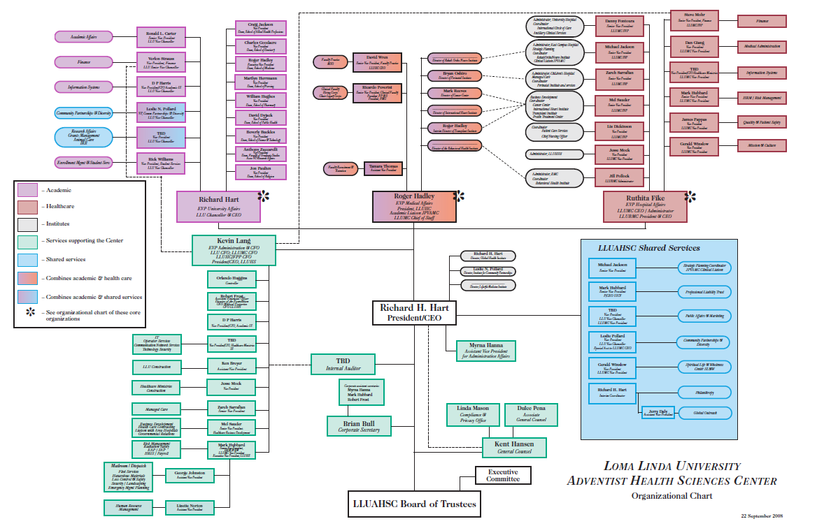
Notes:
But it too is out-of-date. But these charts, and others, gave me the foundation on which to begin constructing a Record Group Schema

Slide 19
Loma Linda University
Department of Archives and Special Collections
University Libraries
RECORD GROUP SCHEMA
LLUAHSC
RECORD GROUP | ENTITY
RG000 | External Information on Loma Linda University
RG00x | Loma Linda University Governing Bodies
RG001 | Board of Trustees
RG001.01 | Minutes
RG001.01.1 | Index
RG001.02 | Members
RG001.03 | Meeting Agendas
RG001.04 | Master Plan Council
RG002 | Board of Trustees - Executive Committee
RG002.01 | Minutes
RG7xx | School of Allied Health Professions
RG700 | School of Allied Health Professions
RG701 | Dean
RG702 | Departments
RG702.1 | Basic Sciences
RG702.2 | Continuing Education
RG702.3 | Cardiopulmonary Sciences
RG702.4 | Clinical Laboratory Sciences
RG702.5 | Communication Sciences and Disorders
RG702.6 | Graduate Studies
RG702.7 | Health Information Management
RG702.8 | Life Support Education
RG702.9 | Nutrition & Dietetic Sciences
RG702.10 | Occupational Therapy Sciences
RG702.11 | Physical Therapy Sciences
RG702.12 | Physician Assistant Sciences
RG702.13 | Radiation Technology Sciences
RG702.14 | Rehabilitation Sciences
RG702.15 | Statistics, Research and Computer Services
RG703 | Publications
RG704 | Events
Notes:
This is not a static document. Names of entities, positions, responsibilities, etc., are ever changing and the schema must accommodate such. I forget how many times the Department of Nutrition and Dietetics has changed names over our 110 year history.
And I kept changing my mind as to how to create the schema. I researched how other schools handled the issue. Looked at examples (when I could find them) and then made a decision to keep it simple but useful. The Dean of Libraries at UCLA once commented to me that rare book catalogers often tried to catalog items down to a gnat’s eyebrow – a bit too detailed to be useful. The same comment could be applied to the categorization process for institutional archives. I could have made the schema much more detailed – subgroups within subgroups ad infinitum. I made the decision to keep it simple. If I want to change it down the road – it’s not chiseled in stone.
If I can get the records and papers at least assigned to a broad record group, I can then spend my golden years refining the organization within.

Slide 20
And now…
As I identify University records
I can cull them out of the chaos
Assign them to their correct Record Group
Organize, box, label and shelve
And of course… create a Finding Aid!

Slide 21
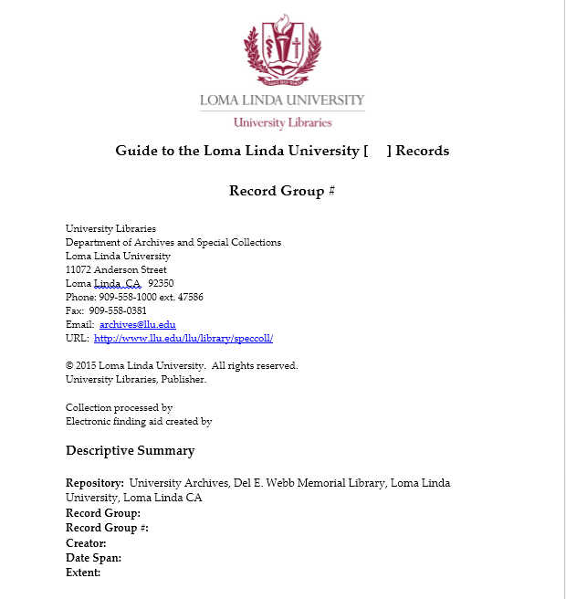
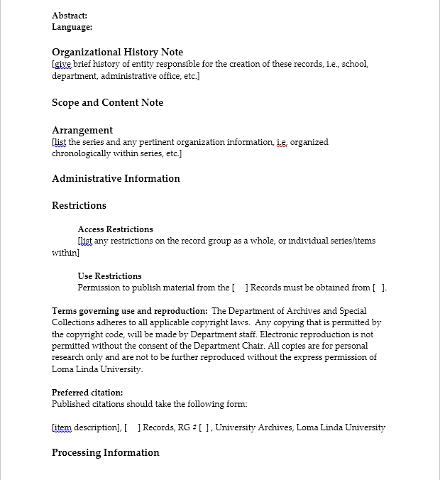
Notes:
Here is the first two pages of the University Archives finding aid template that I created.

Slide 22
By culling out the University’s records
Know where the University Archives is!
Achieve better control over the University’s records, and…
Better control over the non-University archival collections.
I have a long way to go…
Notes:
I want to be able to say that University Archives is more than a cerebral concept, but an actual, physical entity.
I want to be able to go directly to a department’s records to answer a question.
Better control over the non-University archival collections that we own.

