Slide 1
Do We Need Another Form?
Presented by Lori N. Curtis
Chair, Department of Archives & Special Collections
Heritage Research Center
University Libraries
Loma Linda University

Slide 2
Introduction
How does a discussion of forms relate to useful software for managing archives?
Notes:
Tip: Add your own speaker notes here.

Slide 3
Useful Software and Forms: My Argument for the Connection
From my viewpoint, I use software to create forms, and I find forms very useful in managing an archive, thus since the forms are useful, the software used to create them must be useful.

Slide 4
Why Forms
Are forms really useful?
Must you love forms in order to create useful ones?
Do you have to reinvent the wheel in order to create useful forms?
Notes:
Tip: Add your own speaker notes here.

Slide 5
Yes!
Forms HELP you keep track of donations, usage, transfers, paged material, processing, questions and more.
Forms HELP you stay organized!
Forms HELP you build cohesion among your staff
Forms HELP you present a consistent public image

Slide 6
No!
No, you don’t have to love forms like I do in order to create useful ones. I probably should have been a government civil servant somewhere. “Complete this form in triplicate…” But if you weren’t born with the “form” gene, that’s okay.
No, you do not have to re-invent the wheel in order to create useful forms. You can beg, borrow and steal forms from other archives and adapt them to fit your needs. You can find forms online!

Slide 7
What Software Did I Use?
I used Microsoft Word and Adobe Acrobat Professional.
I created the form template in Word and then pulled the document into Adobe to create a “fillable” form that could be filled, saved, distributed, etc., on the computer. The Adobe software has a form wizard that walks newbies through the process. I then saved the finished forms as PDFs. If I need to revise the form, I can edit in Adobe or go back to my Word original and edit then create a new PDF form from that.

Slide 8
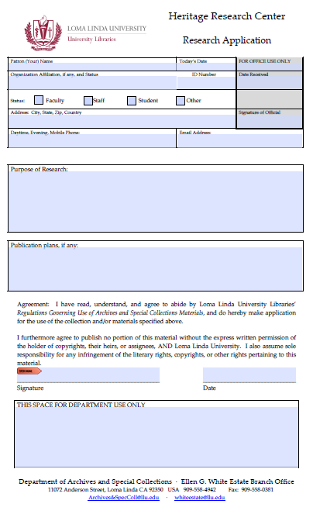
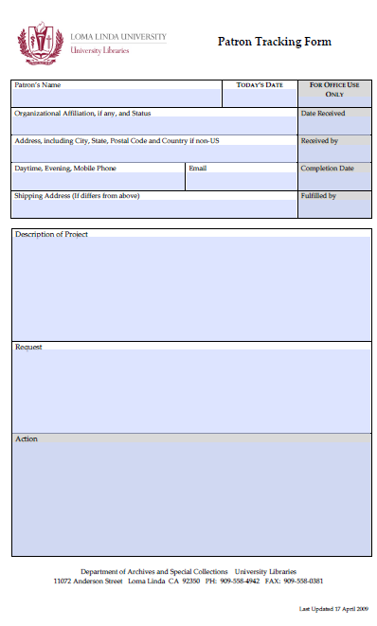
Some Examples …

Slide 9
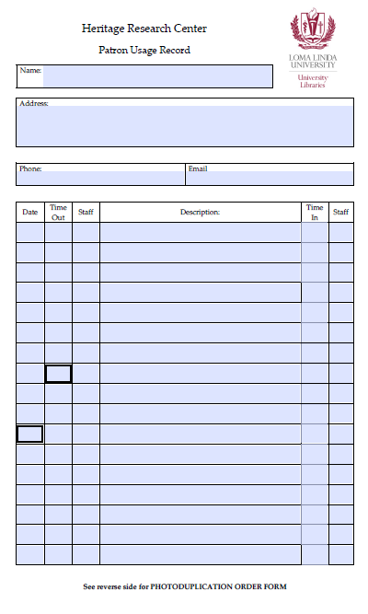
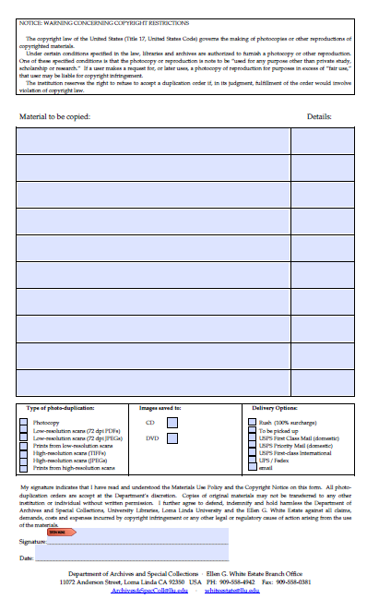
Patron Usage Record

Slide 10
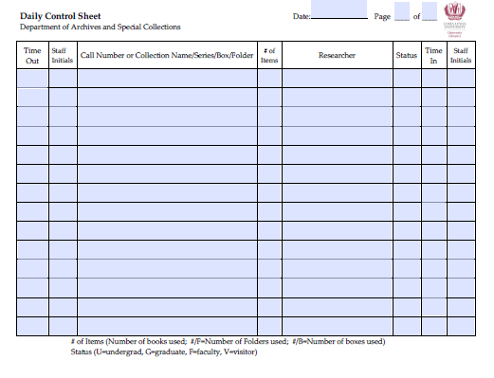
Paging slip - - We use these when paging books, periodicals and such. One form is placed on shelf where item resides; other copy stays with the item pulled. As you type in the top form, the bottom form is automatically populated with the same information. Cool!
Daily Control Sheet
We use this form to keep track of what is “checked out” by our patrons. It also helps us make sure everything is “checked in” at the end of the day.

Slide 11
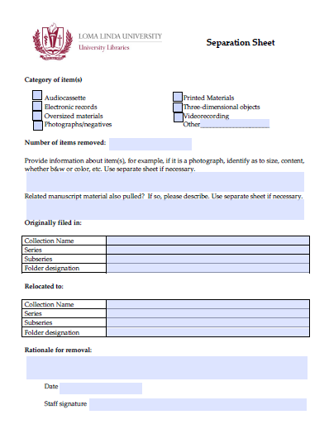
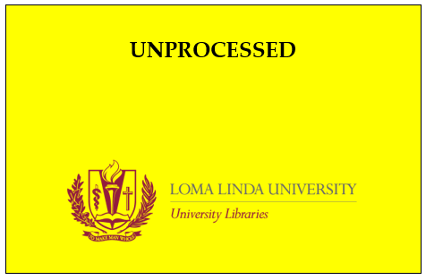
Forms to help with processing…

Slide 12
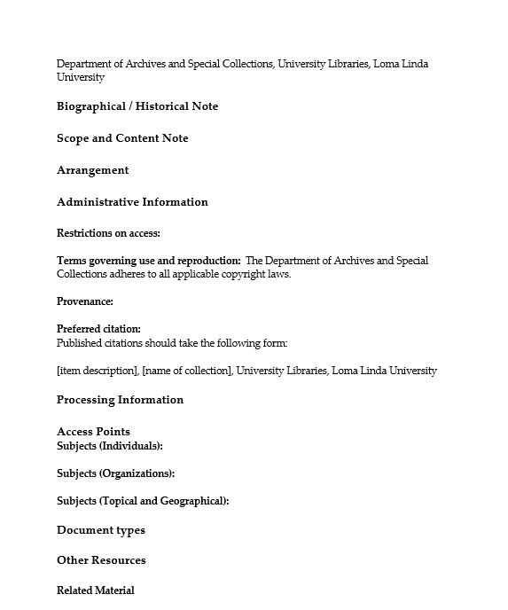
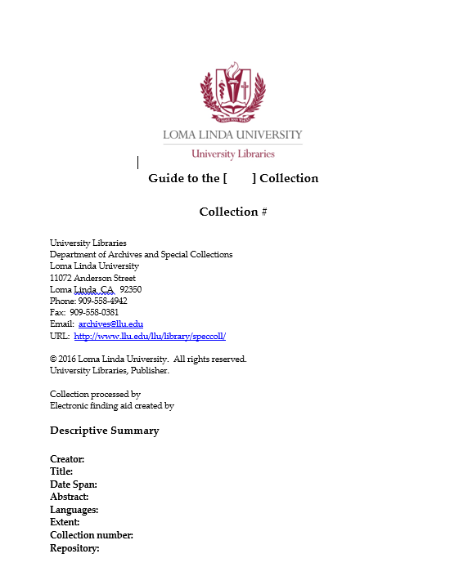
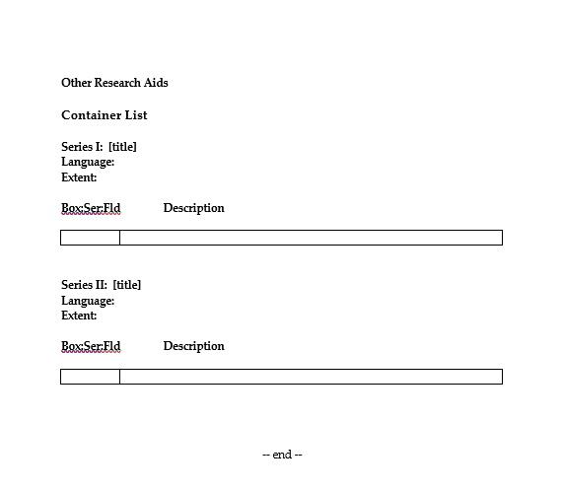
Finding Aids
Staff can easily fill in the requested
information, and know what information
they need to find.

Slide 13
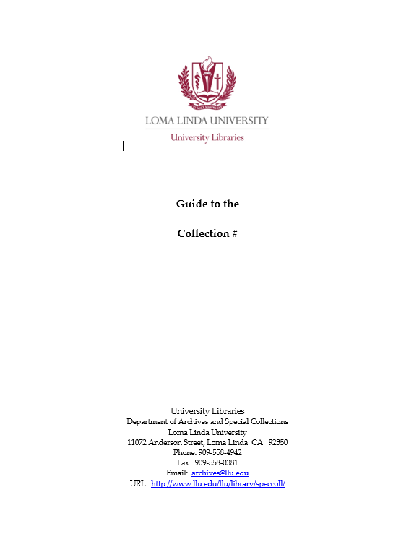
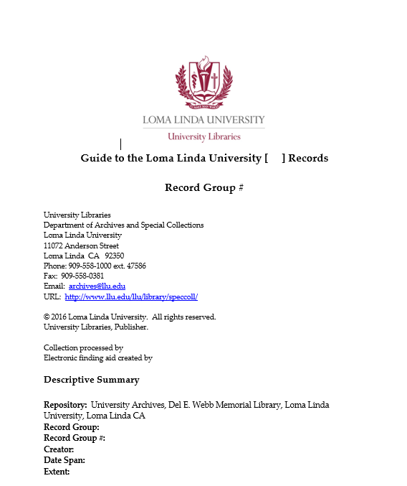
Finding Aid Cover Sheet
Again, the staff member who is creating the finding aid, just fills in the collection name and number. By using the finding aid templates, all of our finding aids have a uniform look with complete information.
We also have finding aid templates and cover sheets for University Archives collections with appropriate wording for such.

Slide 14
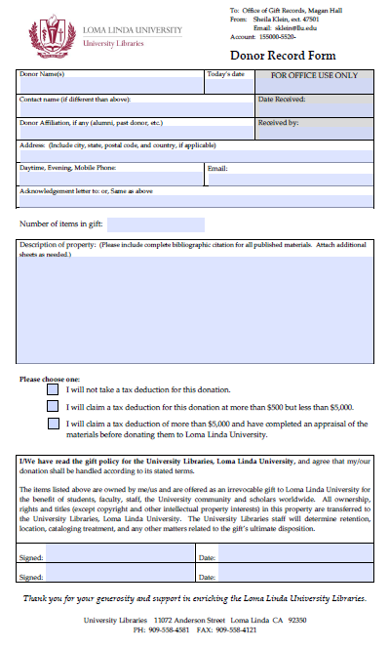
Donations
Collections come to us from a variety of sources. These forms help us keep track of what came in, when, and from whom. A copy of the form is saved on the computer in an ACQUISITIONS folder, a copy is kept with the donation until the donation is processed, then the copy will be placed in the collection file. A copy is given to the donor, and finally a copy is sent to our Gift Records office.
A staff member will also create a detailed item listing of everything that was part of the gift, with notes as to eventual disposition.
A properly completed form also lets us know who accepted the donation so that if questions arise, we know who to ask.

Slide 15
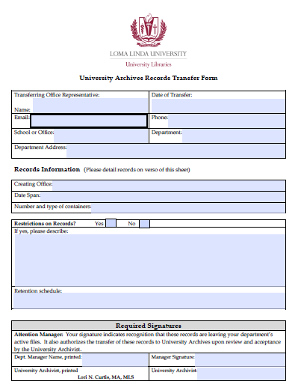
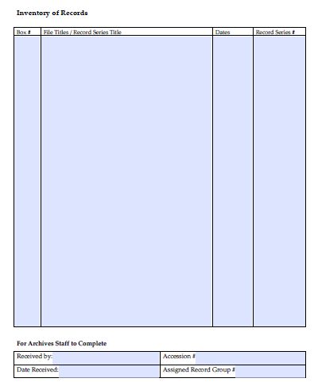
University Archives Records Transfer

Slide 16
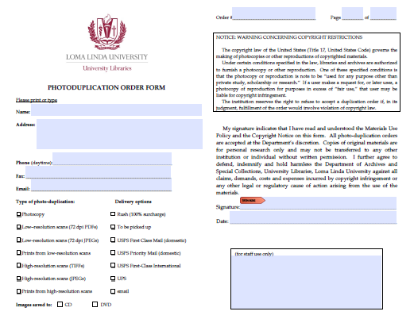
Photoduplication Orders
Yes, we have a form for this as well!

Slide 17
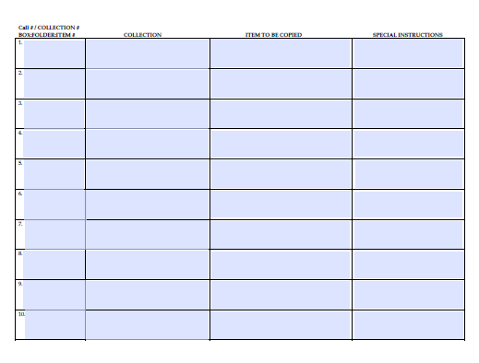
It is a two-sided form!

Slide 18
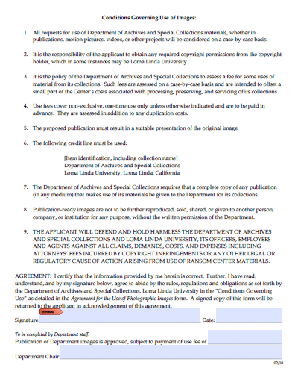
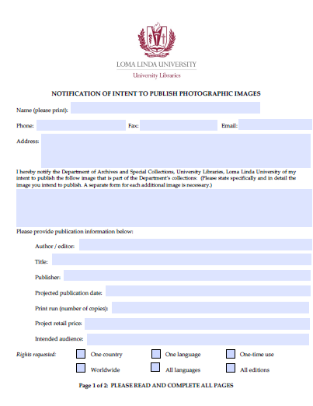
With duplication comes usage. And yes, we have a form for that! Actually several forms, but I will just show you one.

Slide 19
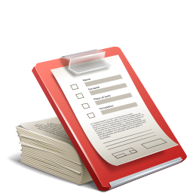
FORMS
We have many other forms that we use for:
Oral History interviews and cataloging
Department Orders
Humidity and Temperature Log
Invoices
Shipping Options
The list goes on! But, I think you get the idea.

Slide 20
How have Forms Helped My Archive?
The Department of Archives and Special Collections was suffering from a bit of an identity crisis when I arrived at Loma Linda University in 2006. Creating forms with a uniform look, department name, and logo was one tool in my kit that helped me create unity and a sense of community among the staff. Not only did the forms help us get organized, they helped us begin working as a unit, as a cohesive department. Working with the staff during the creation of the forms helped garner buy-in and commitment to their use.
Notes:
Tip: Add your own speaker notes here.

Slide 21
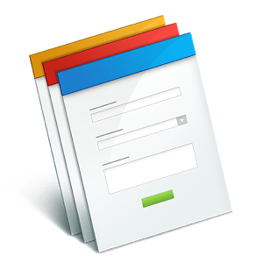
So, what are you waiting for?
Let’s create forms!

